Slide 1
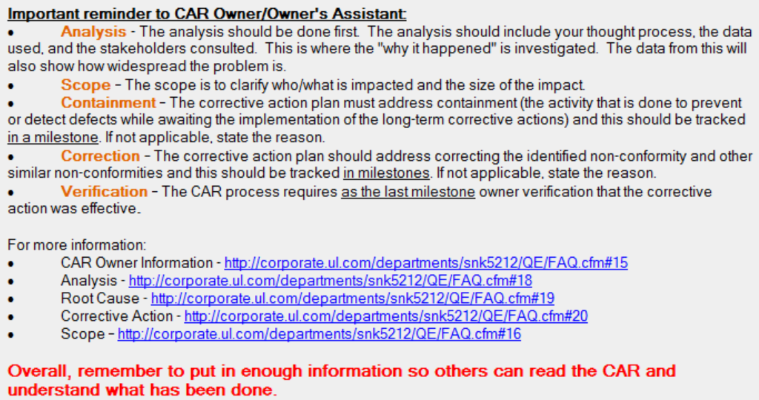
Demonstration of Awesomeness (163915702)
Convenient and well organized instructions/links provided to CAR Owner to kick start process.

Slide 2

Demonstration of Awesomeness
Teamwork assured that CAR progressed in a timely manner
Analysis, Scope of NC, RC, and CAP are articulated well and fully support each other.
The fact that original issues were split into Finding/Observation categories demonstrates attention to detail, flexibility, and strong communication with CAR Owner and Initiator!

Slide 3
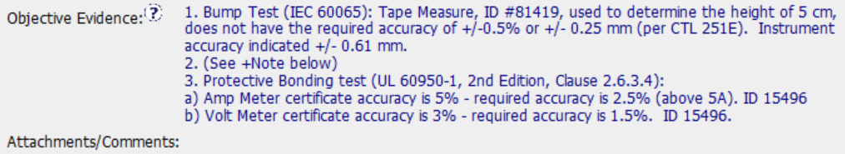

Possible Improvement / Clarification
Per FAQ #3, CAR Champions are assigned to New CARs in accordance with the CAR Administrator Responsibility Matrix.
Audit Report shows (1) Finding under 2016-22-04
CAR Splits Finding # into (1) Finding and (1) Observation (great flexibility), however, moving the objective evidence text to the attachments/comments and including new CAR # there would be good for easy reference. The CARs were linked in the database.
Key Processes / Standard Categories | Number of Findings | Number of Observations | CAR/Audit Finding Number(s)* | SR Number(s)*
Equipment | 1 | 0 | 2016-22-04 | 0

Slide 4
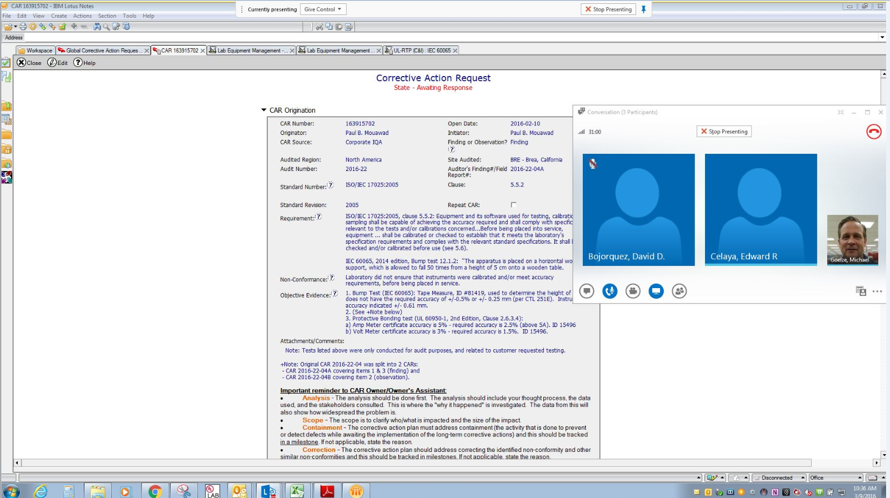
Possible Improvement / Clarification
First Milestone Expectation required evidence of Training on Verifications.
A note in the milestone with a brief summary of training provided at the meeting would supplement the screenshot capturing attendance nicely.

Slide 5
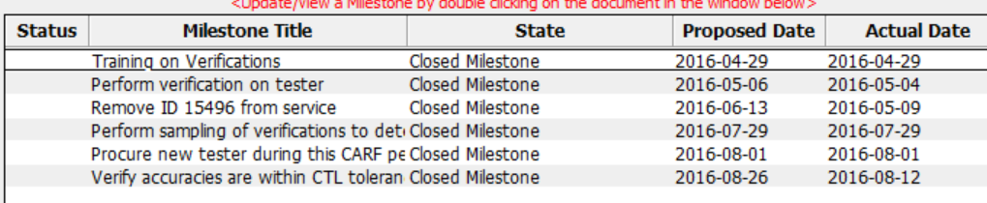
Possible Improvement / Clarification
Containment should be the first action item in Milestones
Suggesting that the CAR Owner combine several milestones might have been helpful to capture all Containment together. The Owner’s proposed date for containment of Instrument ID 15496 suggested taking two months to remove it from service.

Slide 6


Slide 7
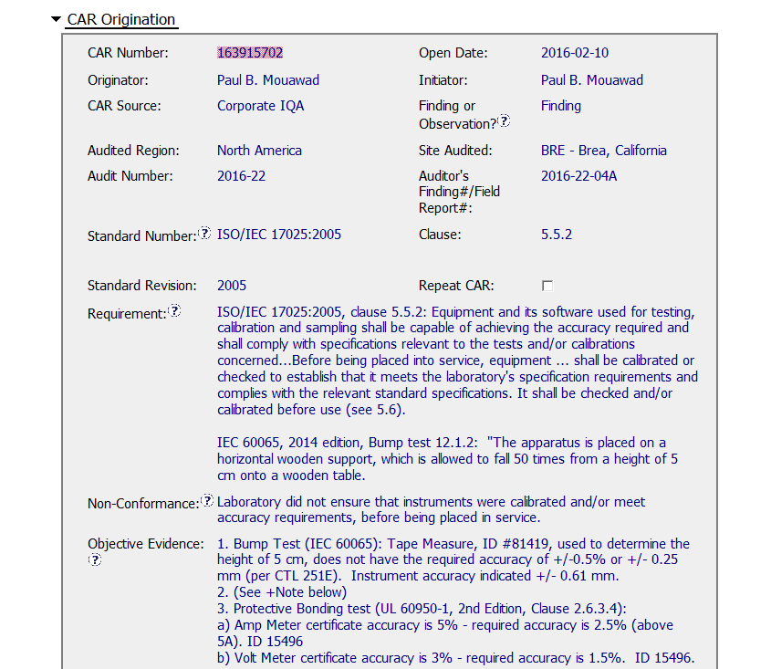
I think the Non-Conformance can be written differently – sounds accusatory

Slide 8
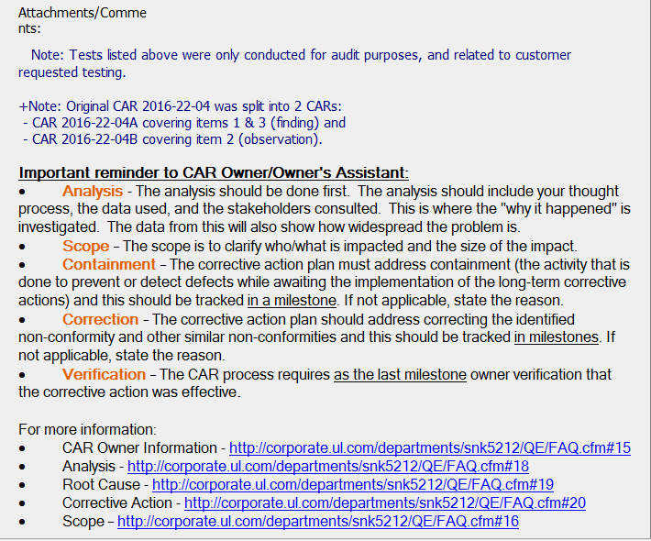
Is “not” missing here?
Nicely done – great information to help the CAR owner

Slide 9

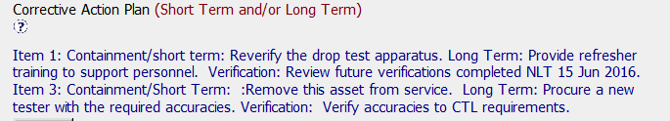
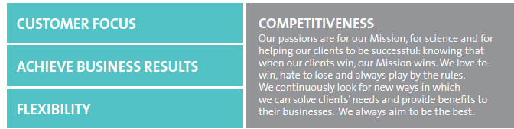
Item 1: Is this a training issue?
Item 3: did the process change since the purchase? Was other equipment purchased that may have the same concern?
Needs Improvement

Slide 10
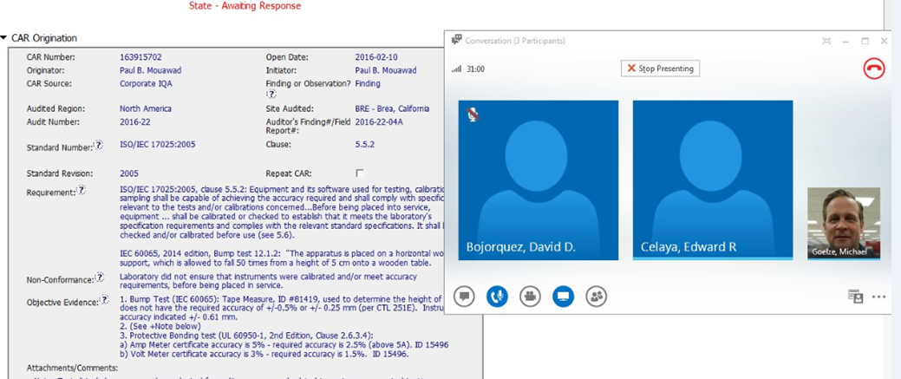
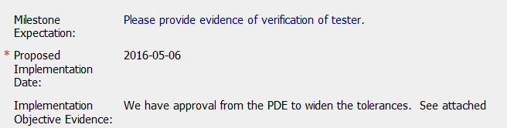
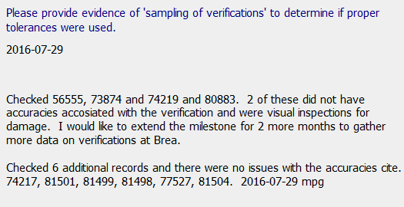
Cool way of showing who attended the meeting
Not only was verification done, but also looked at the tolerances set by PDE to insure accuracy!

Slide 11
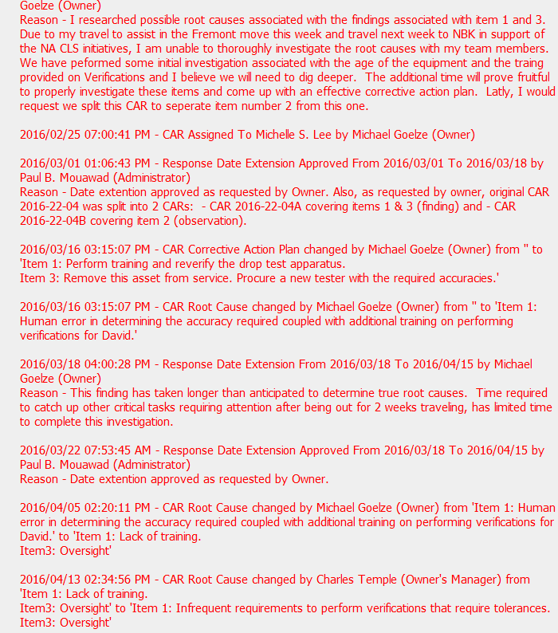
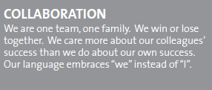

Meets – lots of communication between CAR owner and CAR champion. Additionally helpful information provided from slide 1.
Maybe needs improvement – Lack of training, oversight, human error – is the real root cause missing?

